Slide 1
Deep Learning Tutorial
Xiaoge Zhang
Vanderbilt University, Nashville, TN
March 16, 2018

Slide 2
Introduction to Neural Network
Artificial neural network is an information processing paradigm that is inspired by the way biological nervous systems with a large number of highly interconnected processing elements (neurons) working together to learn from the data.
Deep-learning methods are representation-learning methods with multiple levels of representation, obtained by composing simple but non-linear modules that each transform the representation at one level (starting with the raw input) into a representation at a higher, slightly more abstract level.
The key aspect of deep learning is that the layers of features are not designed by human engineers: they are learned from data using a general-purpose learning procedure.
LeCun, Yann, Yoshua Bengio, and Geoffrey Hinton. "Deep learning." Nature 521, no. 7553 (2015): 436-444.

Slide 3
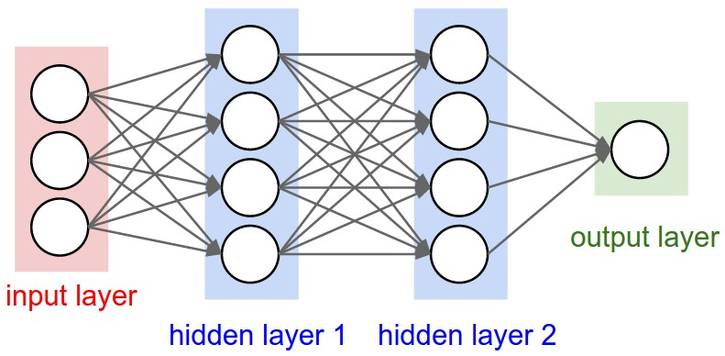
Introduction to Neural Network
There are four key components in a neural network.
Neurons
Activation Functions
Cost Functions
Backpropagation (stochastic gradient descent)
Deep Neural Network (deep learning): number of hidden layers > 2

Slide 4
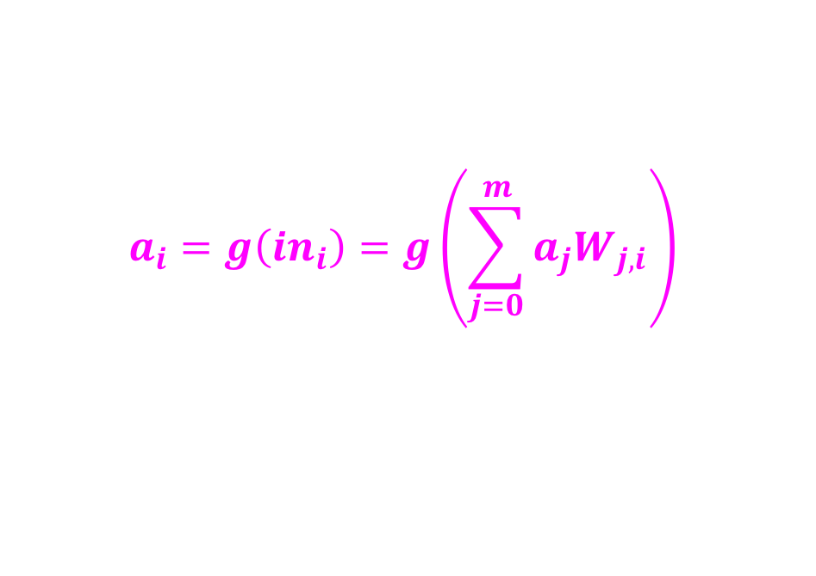
Neurons
Output is a “squashed” linear function of the inputs
$$a_{i}=g\left(in_{i}\right)=g\left(\sum_{j=0}^{m}{a_{j}W_{j,i}}\right)$$
Input links
Input function
Activation function
Output
Output links

Slide 5
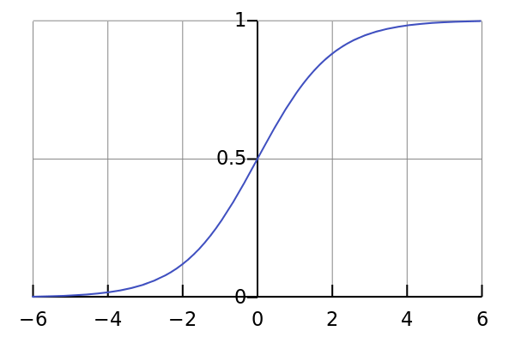
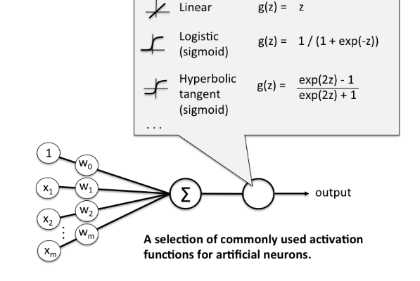
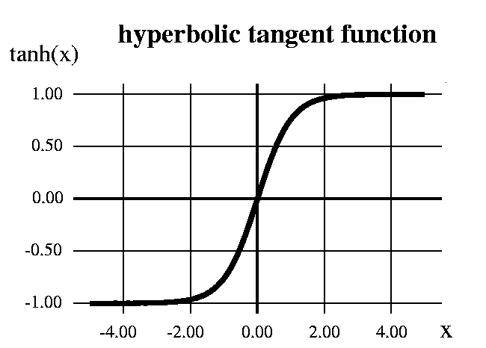
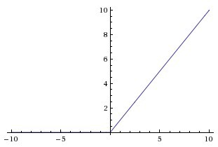
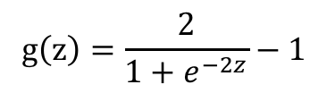
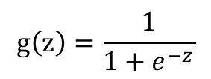

Activation Function
a: sigmoid function
$$g\left(z\right)=\frac{1}{1+e^{−z}}$$
c: tangent function
b: rectified linear unit function
$$g\left(z\right)=\frac{2}{1+e^{−2z}}−1$$
$$g\left(z\right)=max\left(0,z\right)$$

Slide 6
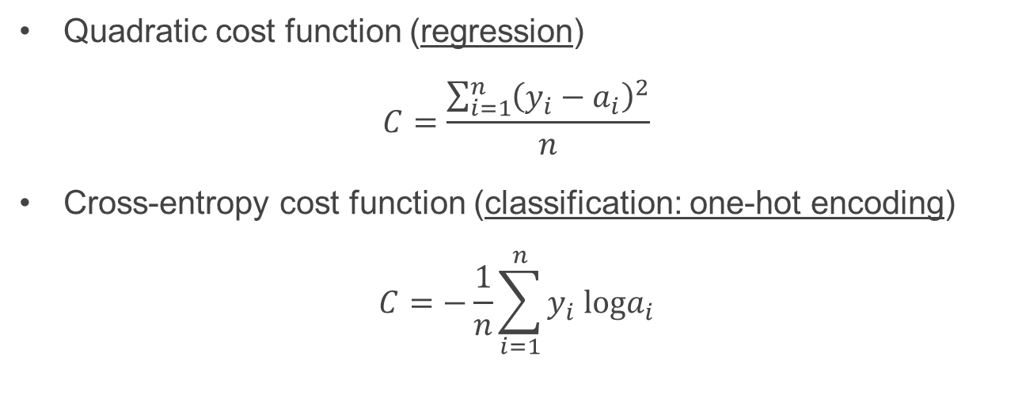
Cost Function
A cost function is needed to measure how far off our predictions are away from the expected value.
y to represent the true value
a to represent neuron’s prediction
Quadratic cost function (regression)
$$C=\frac{\sum_{i=1}^{n}{{\left(y_{i}−a_{i}\right)}^{2}}}{n}$$
Cross-entropy cost function (classification: one-hot encoding)
$$C=−\frac{1}{n}\sum_{i=1}^{n}{y_{i} loga_{i}}$$
http://rdipietro.github.io/friendly-intro-to-cross-entropy-loss/

Slide 7
Backpropagation → learning
Backpropagation is used to calculate the error contribution of each neuron after a batch of data is processed.
It relies heavily on the chain rule to go back through the network and calculate these errors.
Backpropagation works by calculating the error at the output and then distributes back through the network layers through stochastic gradient descent.
It requires a known desired output for each input value (supervised learning).
https://www.youtube.com/watch?v=Ilg3gGewQ5U

Slide 8
Different Types of Neural Networks
Recurrent deep neural network
RNN makes full use of the sequential information, with the output being dependent on the previous computations. They have a “memory” which captures information about what has been calculated so far.
Feed-forward deep neural network
DNN distinguishes itself from the more commonplace single-hidden-layer neural networks by their depth.
In deep-learning networks, each layer of nodes trains on a distinct set of features based on the previous layer’s output. The further you advance into the neural net, the more complex the features your nodes can recognize.
Convolutional deep neural network
CNN is a class of deep, feed-forward artificial neural networks that has successfully been applied to analyzing visual imagery.

Slide 9
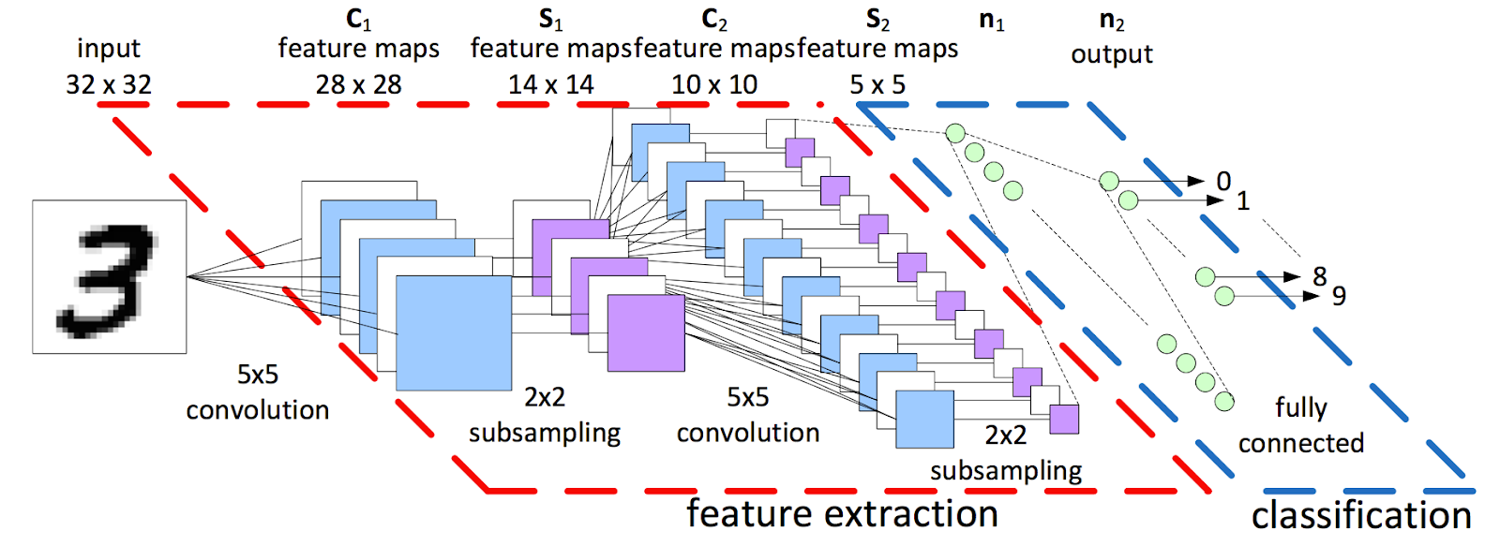
Convolutional Neural Network (CNN)
http://cs231n.github.io/convolutional-networks/

